Slide 1
Endoscopy in Gynecology
Dr. Yashodhara Pradeep
Prof. ObGyn
King George Medical University

Slide 2
Endoscopy in Gynecology
Laparoscopy
Hysteroscopy
Colposcopy

Slide 3
Laparoscopy--Indications
Diagnostic Laparoscopy
Therapeutic or (Operative )Laparoscopy

Slide 4
Indication Diagnostic Laparoscopy
To Visualize pelvic structure uterus , right and left adnexa , structures in right and left iliac fossa and pouch of Douglas,
To know the tubal patency (chrome pertubation)
Ovarian biobsy
Second look surgery

Slide 5
Advantages of Laparoscopy
Shorter hospital stay
Less postoperative pain
Faster return to daily activity
Small incision
Less adhesions
Uterine Surgery
Myomectomy
Hysterectomy

Slide 6
Therapeutic Indication
Tubal surgery:
Tubal ligation
Salpingectomy in case of Ectopic Pregnancy
Salpingostomy in Fimbrial block
Ovarian Surgery:
Oopherectomy
Cystectomy
Ovarian drilling

Slide 7
Therapeutic procedures
Infertility procedures:
Fimbrioplasty
Salpingostomy
Adhesiolysis
Endometriosis
Endometrioma cystectomy plus adhesiolysis
Pelvic Floor repair
Culdoplasty
Enterocele repair
Vault suspension
Paravaginal repair etc

Slide 8
Patient Preparation & Counseling
Counseling about the procedure & expected outcome
Bowel Preparation to facilitate the visualization of operative area & reduced chances of bowel injury

Slide 9
Limitation of Laparoscopy
Reduced exposure of operating field
Skilled person
Expensive Instruments
Cost is high
Prolonged operating time
Prolong anaesthesia
Increased risk of complication in less skilled person

Slide 10
Equipment & Technique
Patient positioning
Operating room organization
Peritoneal access
Visualization
Manipulation of tissue & fluid
Cutting, haemostasis, &tissue fastening
Tissue extraction
Incision management

Slide 11
Laparoscopic Procedure
Midline infra umbilical incision
Lifting of Abdominal wall
Insertion of Insufflation needle or (Varies needle)
Creation of pneumoperitoneum with CO2
Check the needle position in peritoneal cavity
Intraperitoneal Pressure for placement of trocar &canula 20-25 mm then reduced to 10-12 mm
Insertion of Laproscope with camera after white balancing
Creation of ancillary ports
Maintaining peritoneal distension

Slide 12
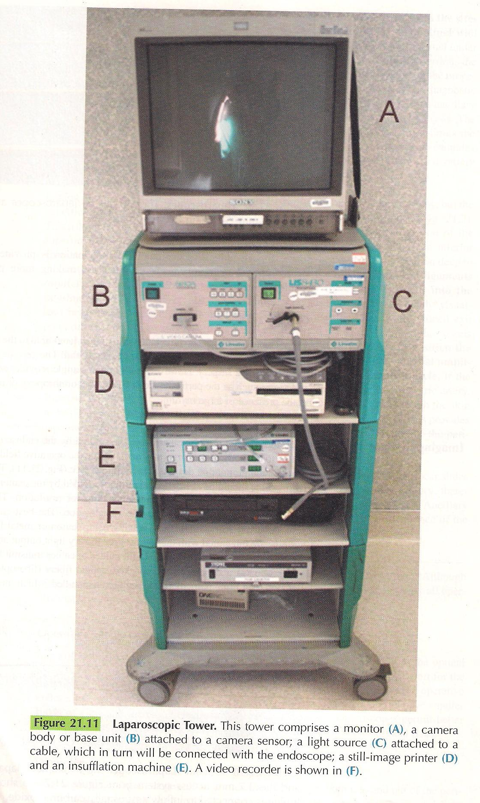
Notes:
There is monitor, light source, camera body and base unit, Printer, Insufflation unit, video recorder

Slide 13
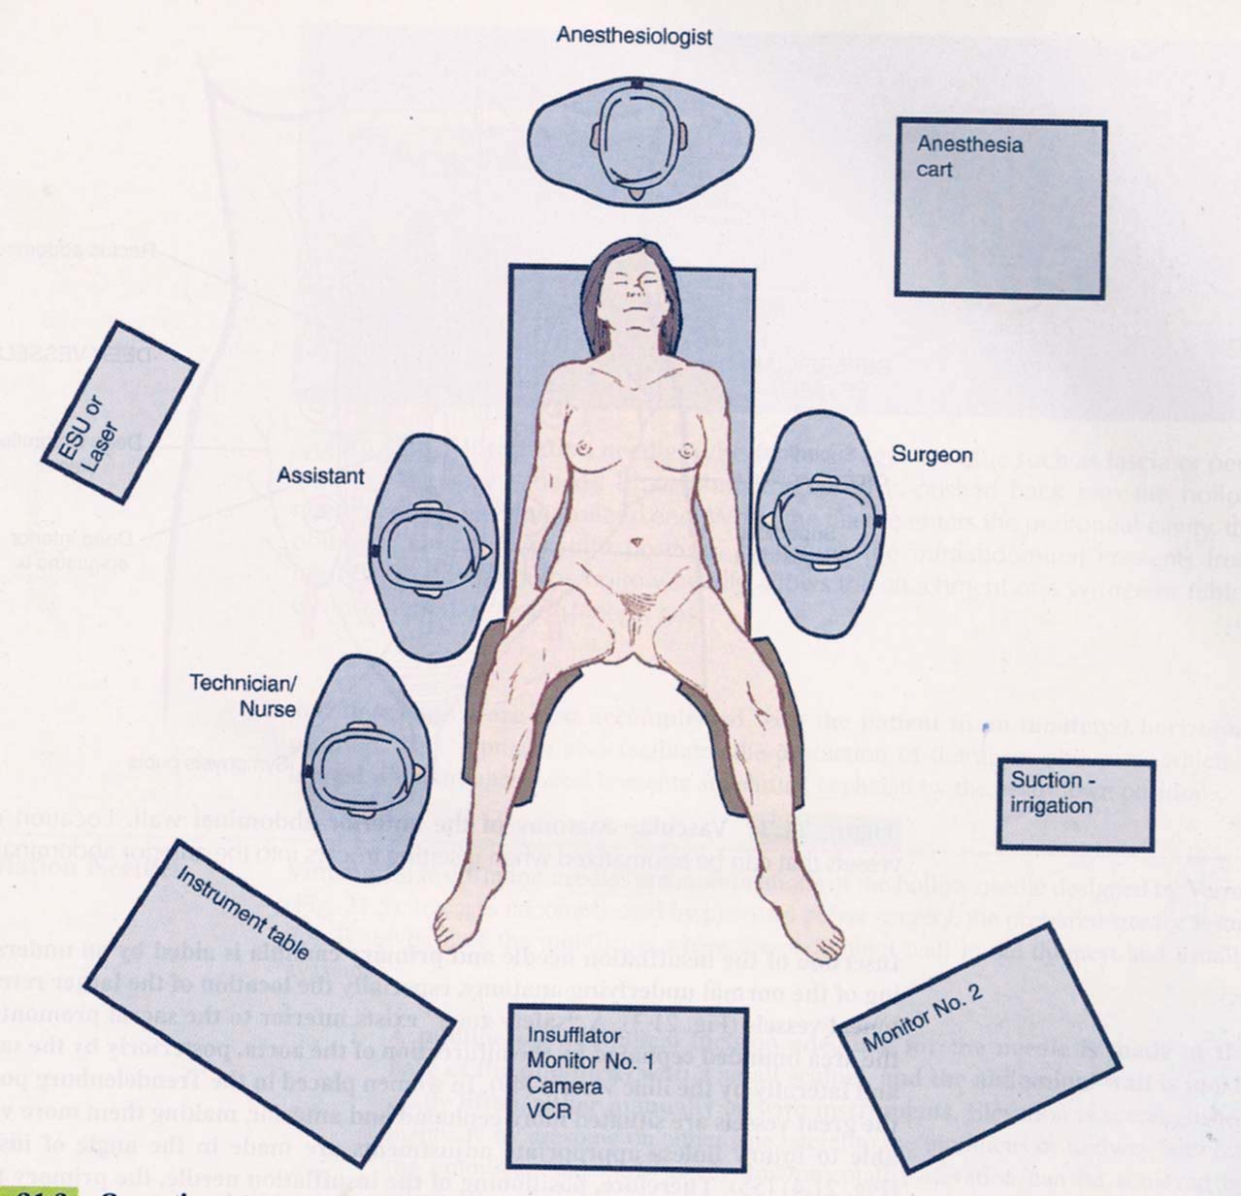

Slide 14
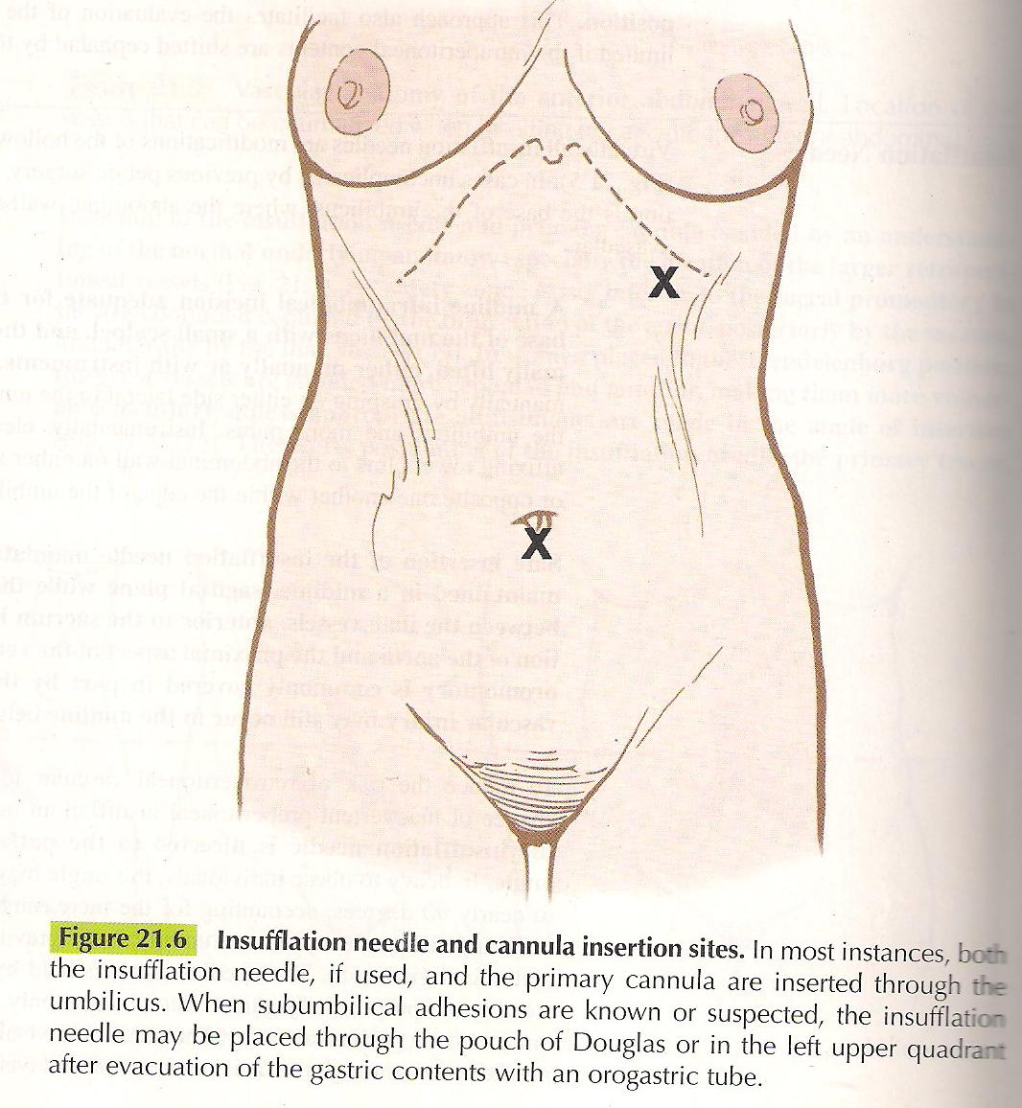
Insertion site of Insufflation needle and primary canula
Notes:
Insufflation and canula insertion sites both insufflation needle and primary canula is insereted through umbilicus, in case of suspicion of subumbilical adhesions insufflation needle is inserted through vagina or upper left quadrant after emptying the gastric content

Slide 15
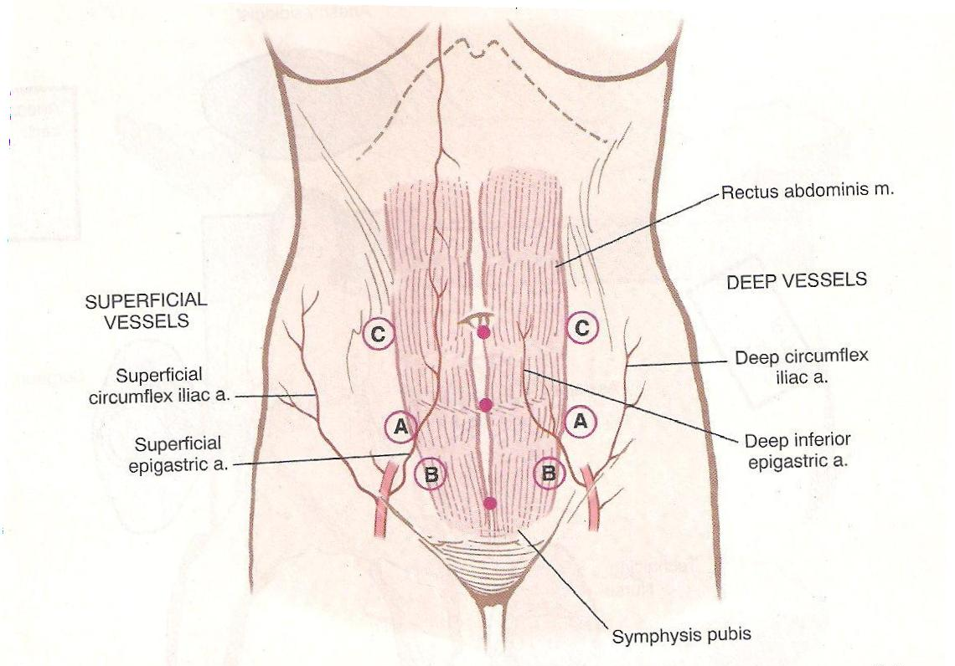
Notes:
Vascular Anatomy of Anterior abdominal wall, Location of vessels that can be traumatized when inserting trocars into anterior abdominal walls

Slide 16
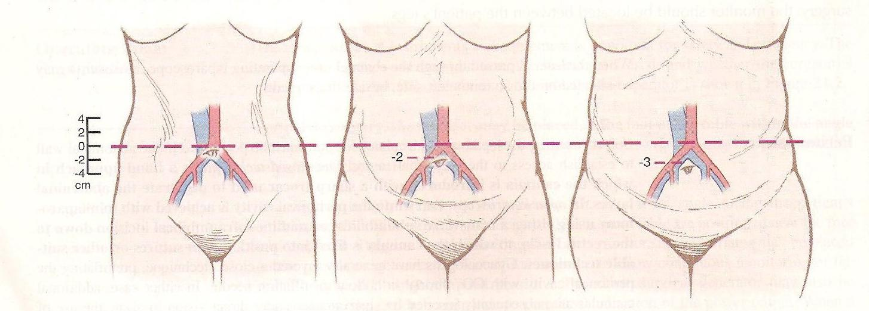
Notes:
Vascular anatomy Location of the great vessels and their relation ship with umbilicus as the obesity of patient increases; the bifurcation of aorta and common iliac goes above the umbilicus instead of at the umbilicus in normal weight patient vessel

Slide 17
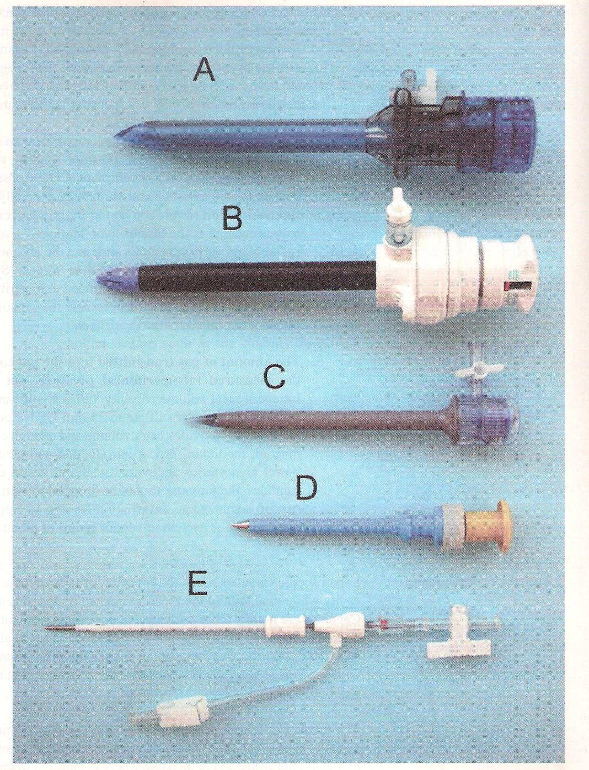
Disposable Trocar’s of
Various sizes 12mmto 2.7mm
Notes:
Internal diameter of trocar 12mm (A)blunt(B) with deployable blade which can cut the ant. Abd. Wall, C&D are 5 mmTrocar E is 2.7 mm canula Trocar is long insufflation needle

Slide 18
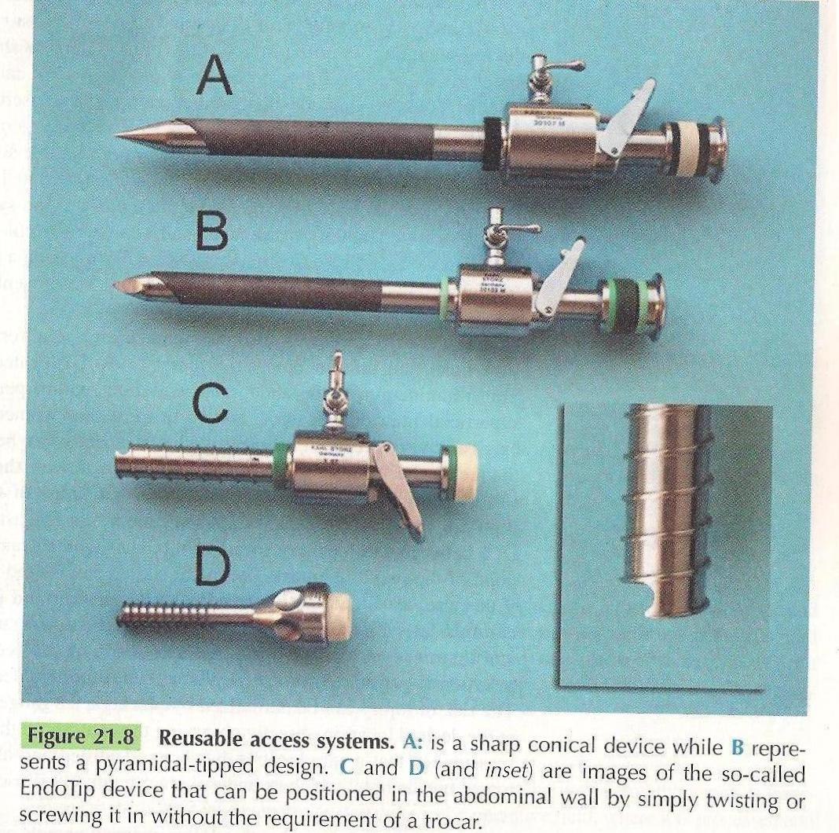
Reusable Devices
Trocar and canula
Notes:
Reusable devices sharp conical tip, pyramidal tipped design, C,D& Inset Images are endotip devices that can be positioned in abdominal wall by simple twisting and screwing it in without trocar

Slide 19
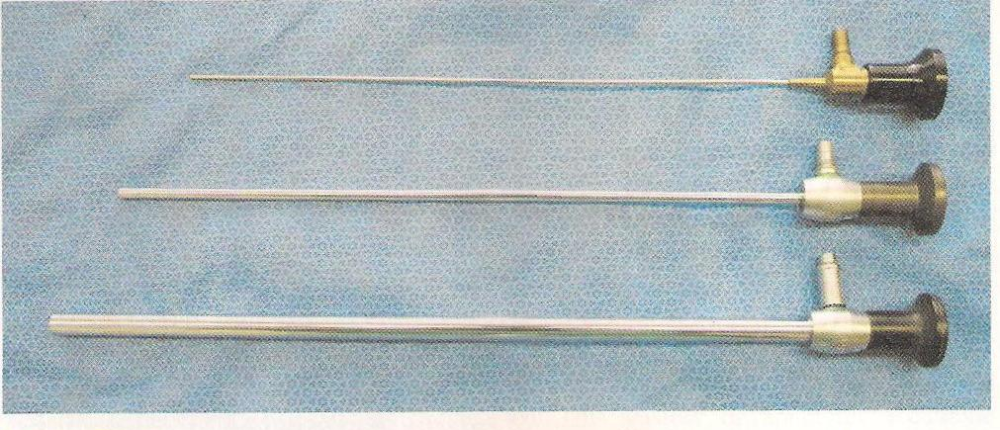
Laparoscope odegree2,5,10 mm
Notes:
0 degree laparoscope 2, 5, 10 mm.

Slide 20
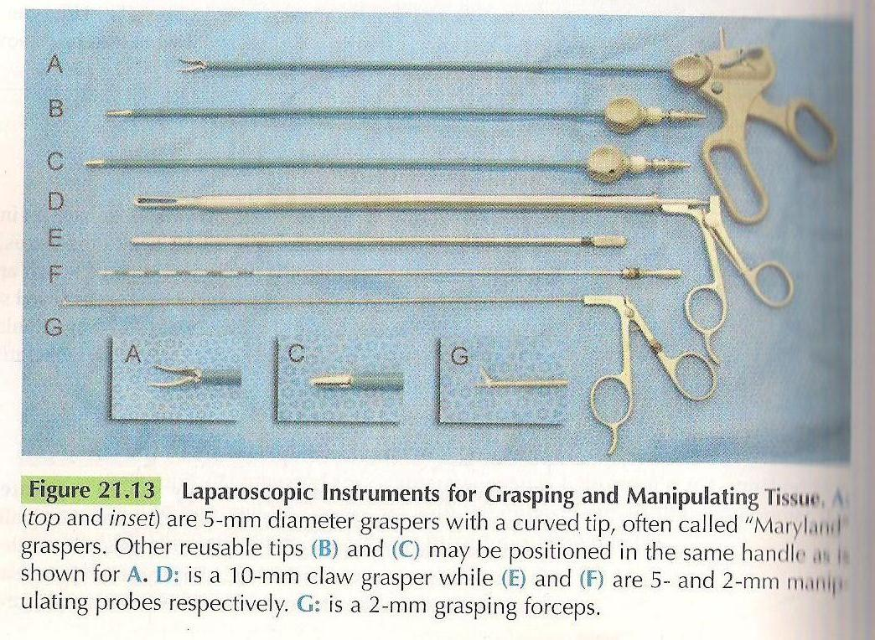
Graspers Curved Straight and manipulators
Notes:
Lapraoscopy instruments for grasping and manipulating tissue, Mayland grasper curved tip 5mm, 10mm grasper, 5and 2 mm manipulating probes

Slide 21
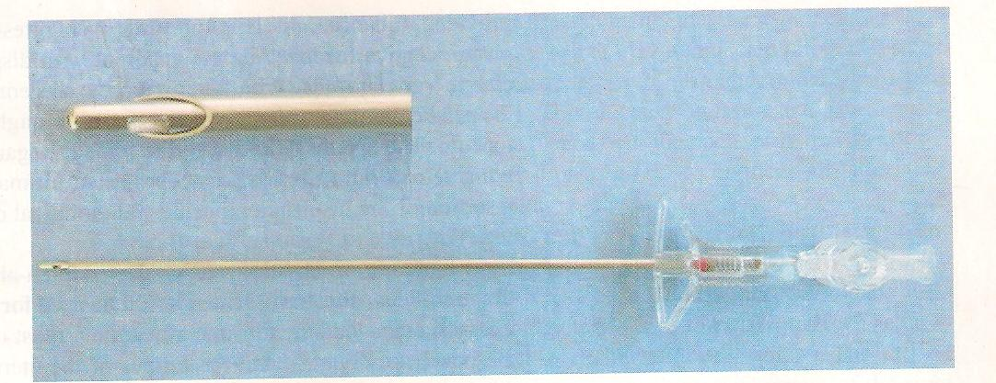
Insufflation Needle
Notes:
Insufflation needle spring head for distension with gas

Slide 22
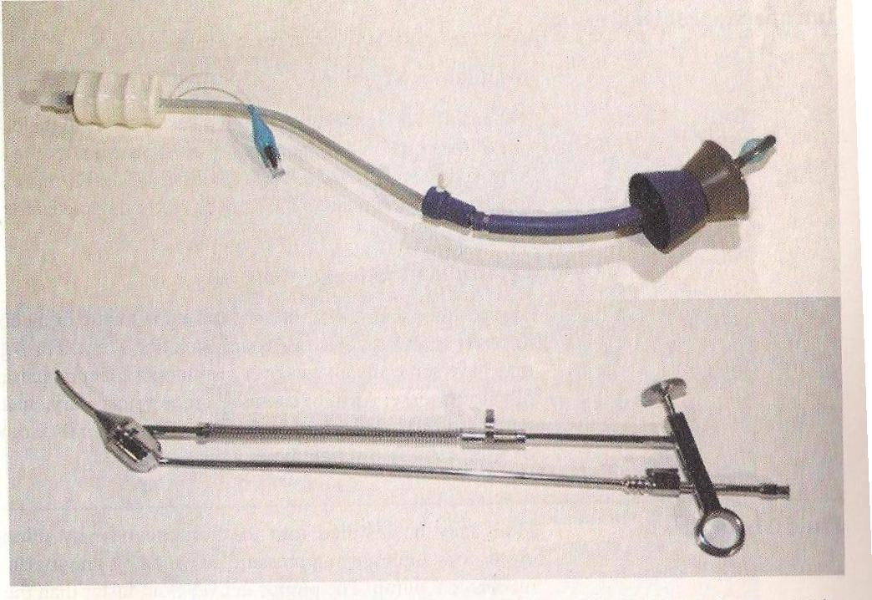
Uterine manipulator
Notes:
Uterine manipulators, Vcare device. At the tip ballon inflated to mainain the device in uterine cavity down is Pelosi manipulator the ring handle allows the surgeon to antevert the uterus

Slide 23
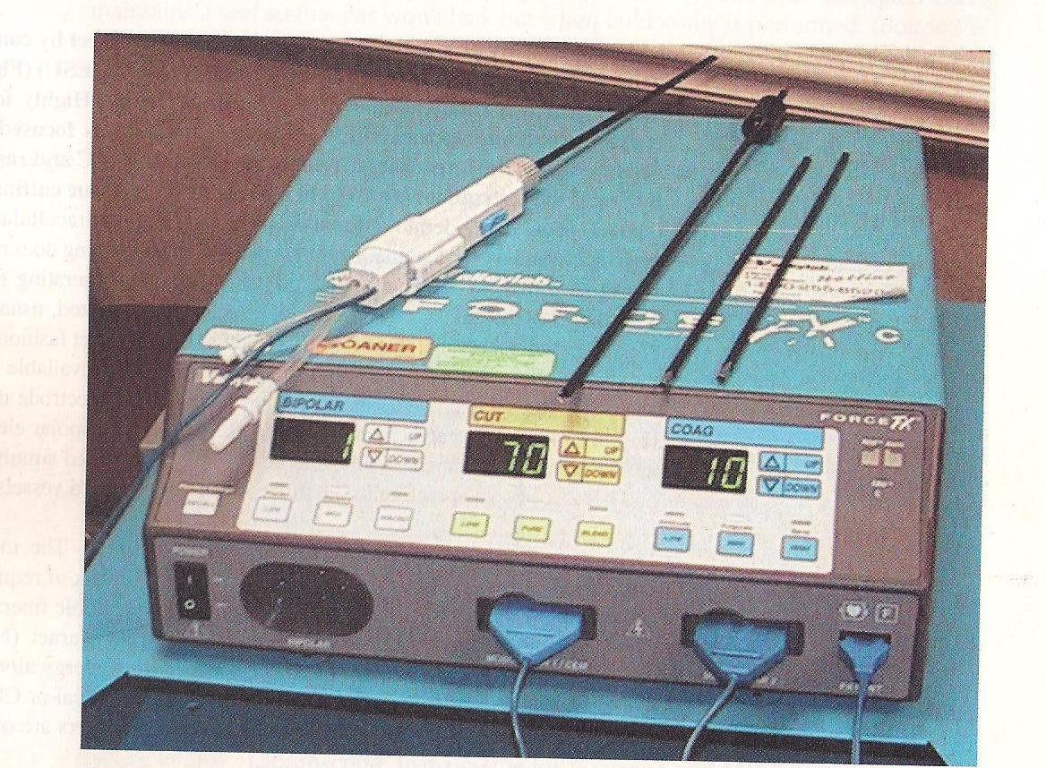
Radio frequency electrosurgical generator
Notes:
Radiofrequency electrosurgical generator unipolar laparoscopy electrode. High voltage coagulation and low voltage cut waveforms, for low voltage bipolar circuit and instruments

Slide 24
Ligating cutting and shearing device
Notes:
A-C Ligating cutting shearing device based on same technology as the harmonic scalpel; D-F is bipolar radiofrequency device coagulation and cut

Slide 25
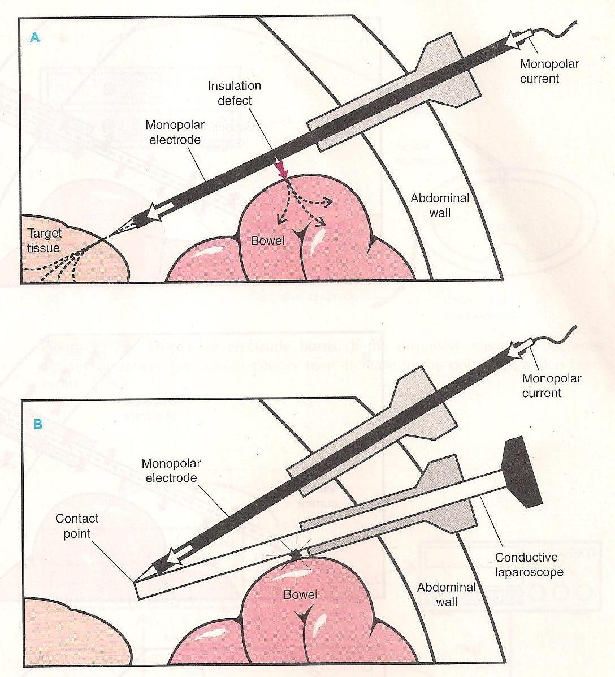
Insulator Defect
Direct contact coupling
Notes:
A there is monopolar current and defect in insulation can burn the bowel; monopolar instrument comes in direct contact of conductive laparoscope and toches the bowel cause damage

Slide 26
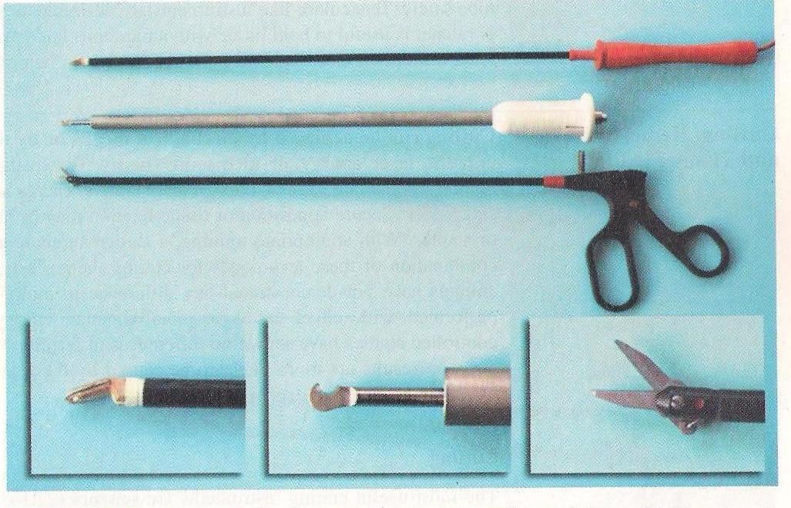
Laparoscopic Cutting devices
Notes:
Laparoscopic cutting devices bipolar electrosurgical spatula , Middle and center Inset Harmonic Scalpel the device oscillates at 55,000 Hz to cut tissue, Laparoscopic scissors

Slide 27
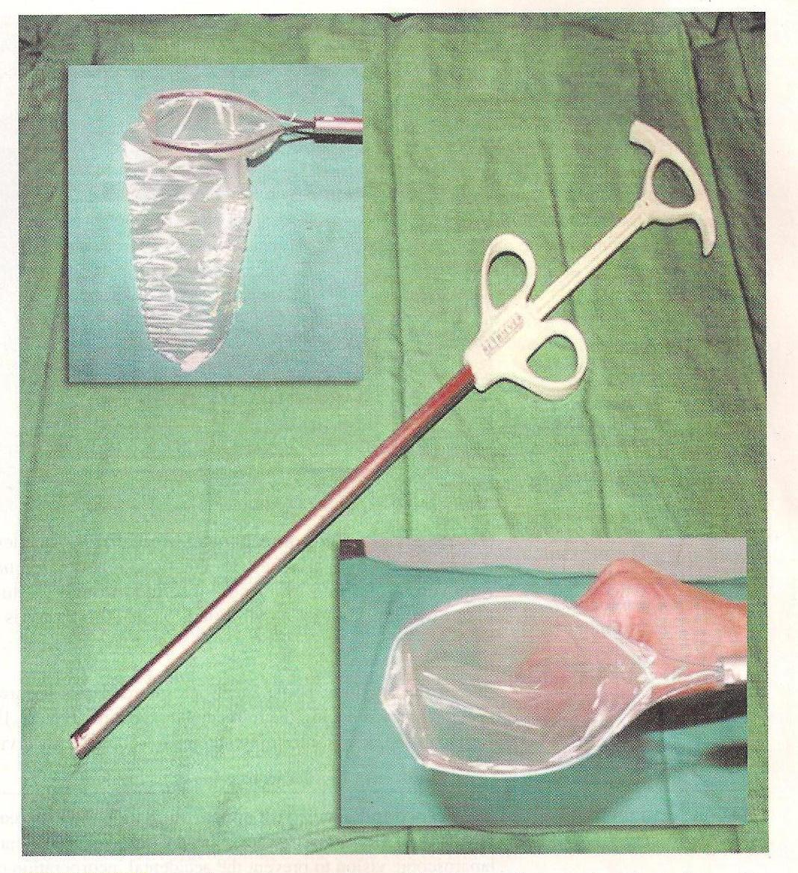
Specimen removal bag
Notes:
Specimen removal bagm positioned in peritoneal cavity

Slide 28
Electromechanical Morcellator
Notes:
Electromechanical morcellator, this device is positioned in peritoneal cavity and attached to power generator, the blunt obturator is removed and grasping instrument is inserted through the lumen is used ti withdraw the tissue, whish is cut by cylundrical blade the motor is activated by foot pedal

Slide 29
Complications
Anaesthesia Complications:
Hypoventilation
Esophageal intubation
Gastro esophageal reflux
Broncho spasm
Hypotension < venous return sec. to high intraperitoneal pressure
Narcotic overdose
Carbon dioxide embolus
Cardiac Arrhythmias dt hypercarbia & acidemia
Cardiac Arrest

Slide 30
Complication
Extra peritoneal Insufflation
Emphysema
Electrosurgical complications :
thermal visceral injury &current diversions
Hemorrhagic complications –
Great vessels : aorta, common iliac, int.&ext. iliac vessels & their branches
Abdominal wall vessels : superficial circumflex iliac vessels, superficial inferior epigastric vessels(SIEV), Deep inferior epigasrric iliac vessels;(DIE IV) ,deep circumflex iliac vessels (DCI V )

Slide 31
Complications
Gastro Intestinal Injury:
Stomach , Small Bowel, & the Colon
Urologic Injury:
Bladder
Ureter
Neurological Injuries:
Due to poor positioning , pressure or surgical dissection
Infection
Incisional hernia
Wound dehiscence

Slide 32
Hysteroscopy

Slide 33
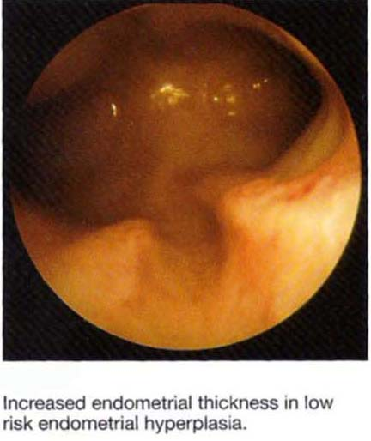
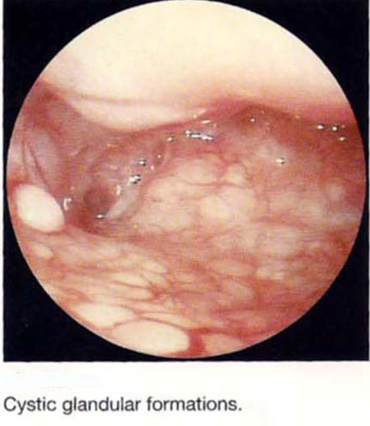
Causes of AUB
Post pregnancy Metrorrhagia
Endometrial hyperplasia
Sub mucous Fibroid or fibroid at other site
Endometrial Polyp
Foreign body
Lost IUCD
Endometrial Atrophy
Endometrial cancer

Slide 34
Indication for Hysteroscopy
Unexplained abnormal uterine bleeding
Reproductive age group
Premenopausal
Postmenopausal
2. Selected infertility cases
Abnormal hysterography or transvaginal ultrasonography
Unexplained infertility
Asherman’s syndrome
Recurrent spontaneous abortion
Congenital uterine abnormality a Bicornuate uterus, Subseptate, Septate uterus, uterus didelphous

Slide 35
Operative procedures
Endometrial biopsy site specific
Foreign body removal
Dissection of septum
Endometrial polyp removal
Myomectomy of sub mucous fibroid
Endometrial ablation
Trans cervical tubal catheterisation
Sterilization
Adhesiolysis in Uterine synechia

Slide 36
Contraindication
Infection
Pregnancy
Malignancy
Bleeding
Cardiopumonary Disorder
Cervical Stenosis

Slide 37
Intra operative Complications
Trauma
Hemorrhage
Complications related to distension media
Infection
Thermal damage caused by the electric current
Cervical or uterine perforation 1-9%

Slide 38
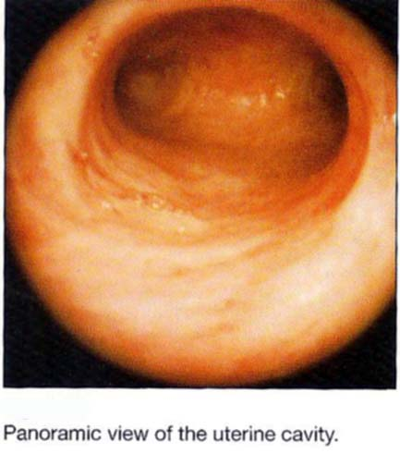
Equipment and Technique
Patient positioning and cervical exposure
Anesthesia
Cervical dilation
Uterine distention
Imaging
Intrauterine manipulation

Slide 39
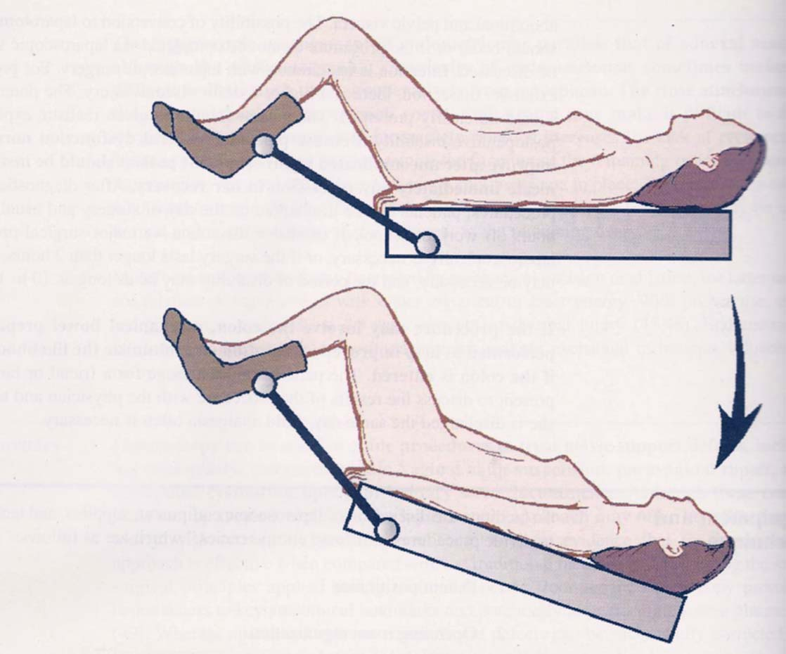

Slide 40
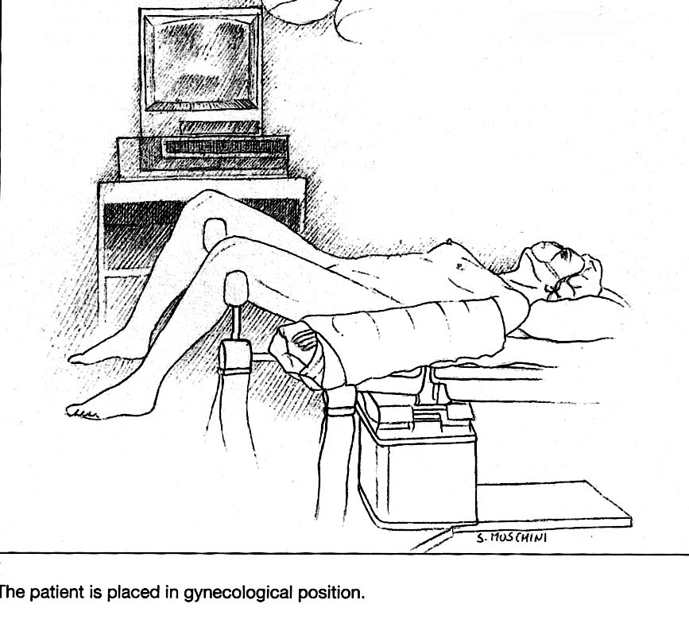

Slide 41
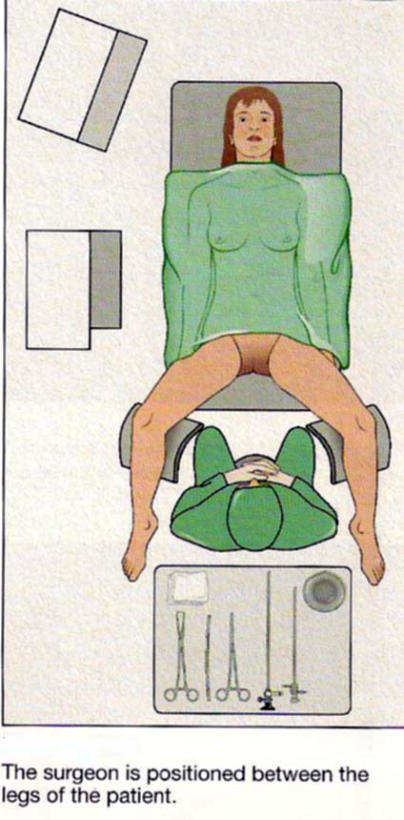
Notes:
Surgeon is positioned between the patient

Slide 43
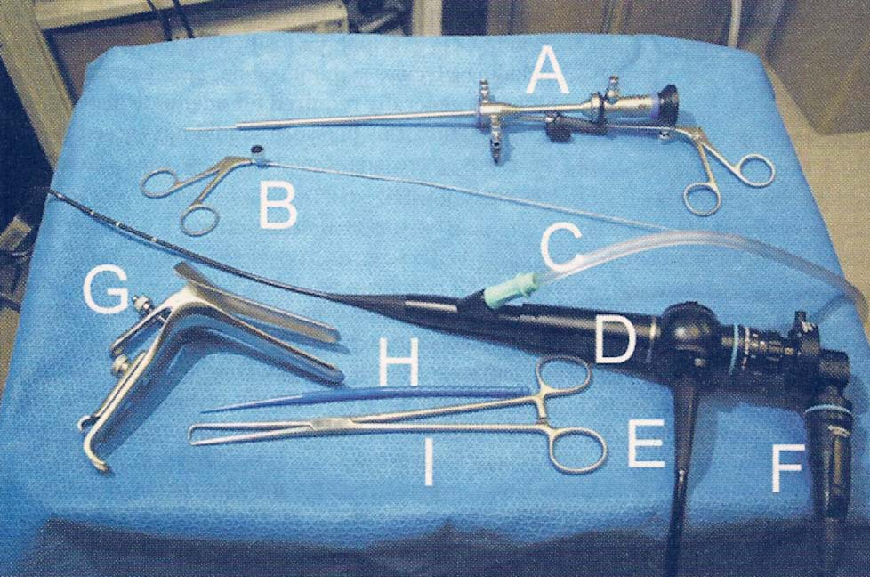

Slide 44
Distension media
Carbondioxide
Dextran 70
Low viscosity fluids
1.5 %Glycine
3 % Sorbitol
5 % manitol

Slide 45
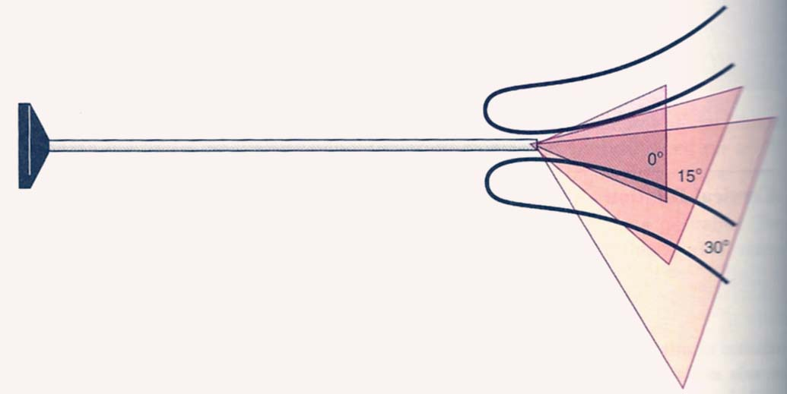

Slide 46
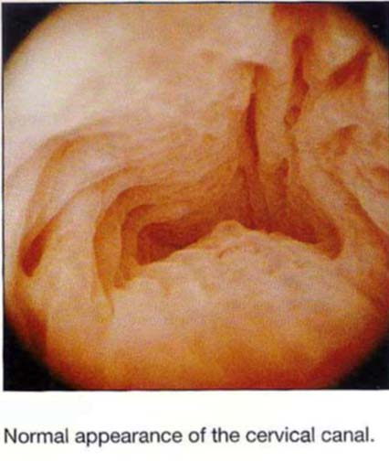

Slide 47
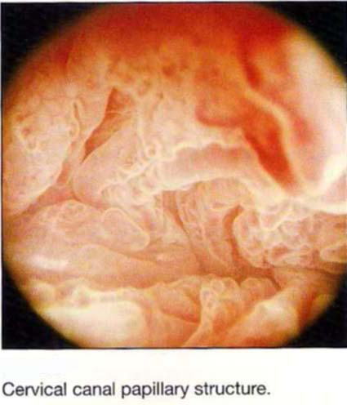
Cervical Canal Papillary structure

Slide 48
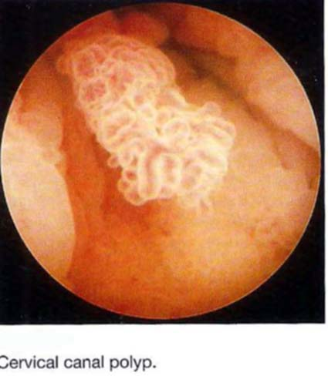
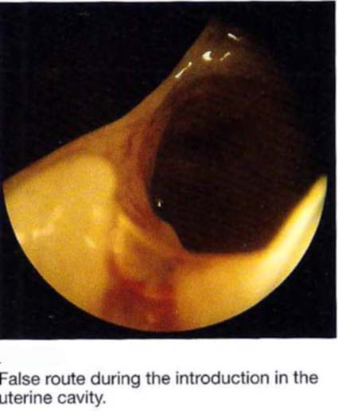

Slide 49
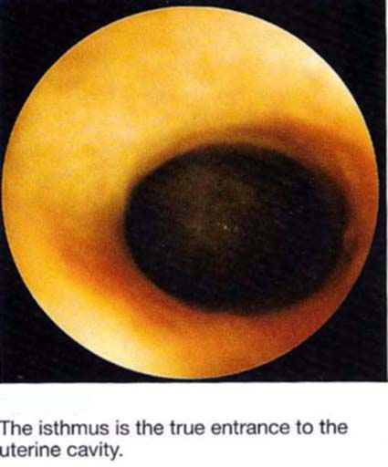

Slide 50
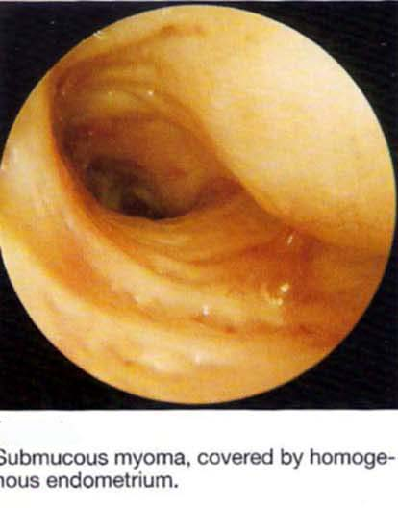
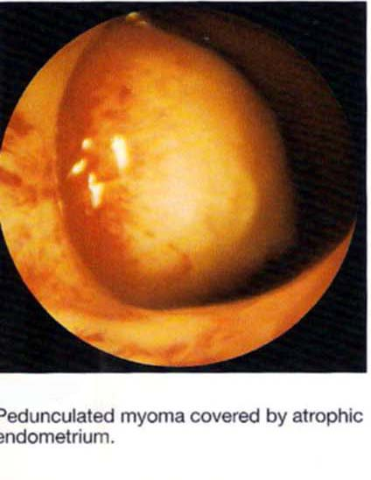
Submucous Fibroid Pedunculated Myoma

Slide 51
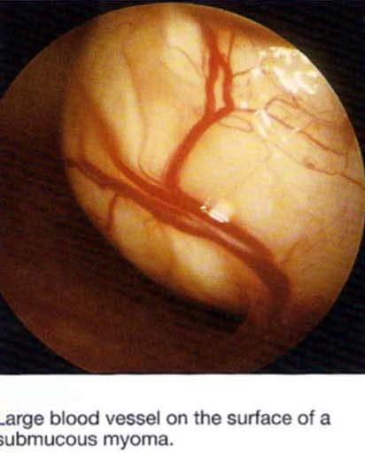
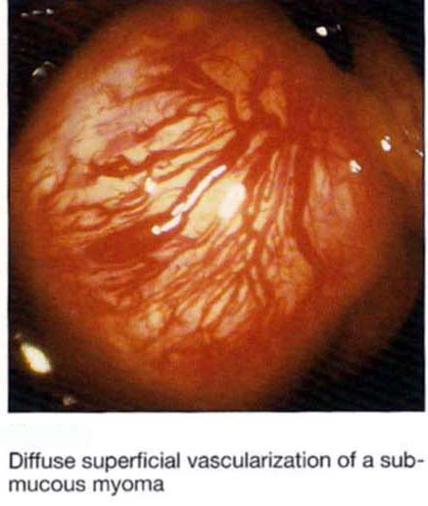
Vascularisation of Submucous Fibroid

Slide 52
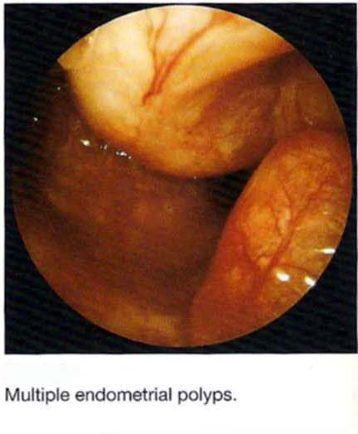
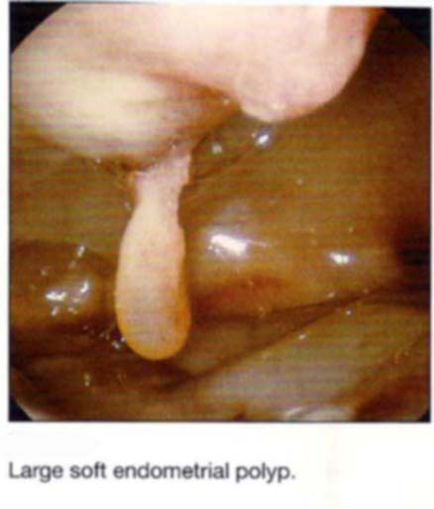

Slide 53
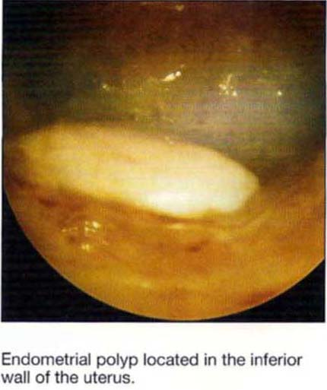
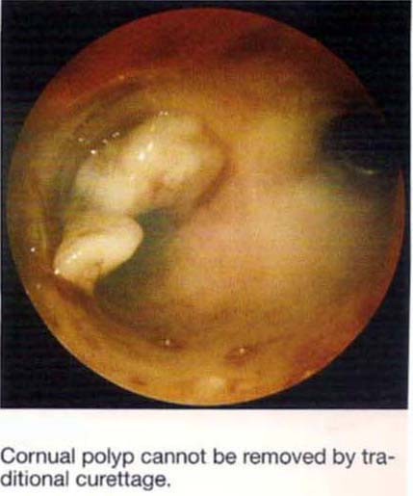

Slide 54
Endometrial Ablation
Introduction :
Introduced in1980, for destroying the endometrium in women with abnormal uterine bleeding with the aim of reducing or totally eliminating the bleeding
Abnormal uterine bleeding is common gynecological problem
Medical treatment often has transitory effect

Slide 55
Indication
Abnormal uterine bleeding not responding to medical management, & the case is neither premalignant or malignant
Recurrent endometrial hyperplasia without Atypia
Although in selected cases of above category can be done
It can be done under local anaesthesia

Slide 56
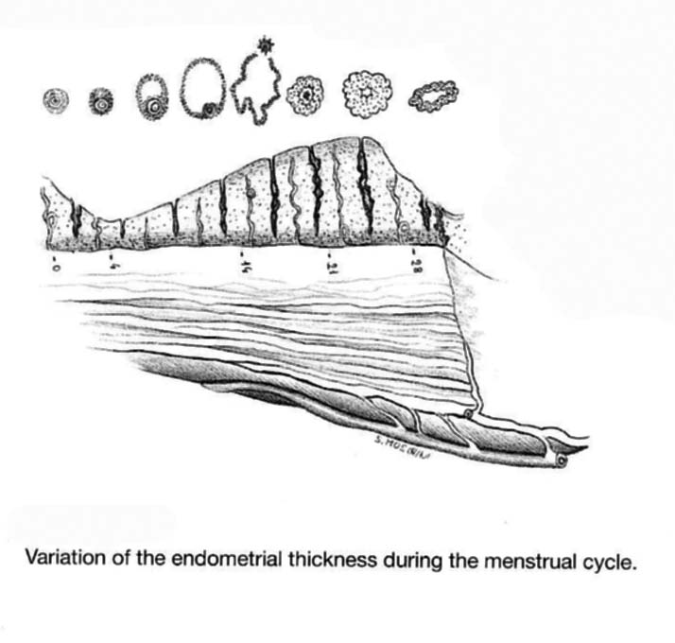
Preoperative Preparation
To ensure complete ablation of the mucosa a homogeneous &thin endmt. must be achieved by GnRH analogs or danazol for 2-3 months
Aspiration of the endmt or curettage
Prophylactic antibiotic tt

Slide 57
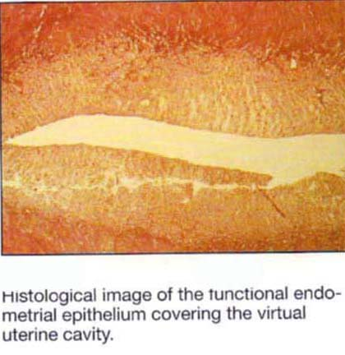

Slide 58
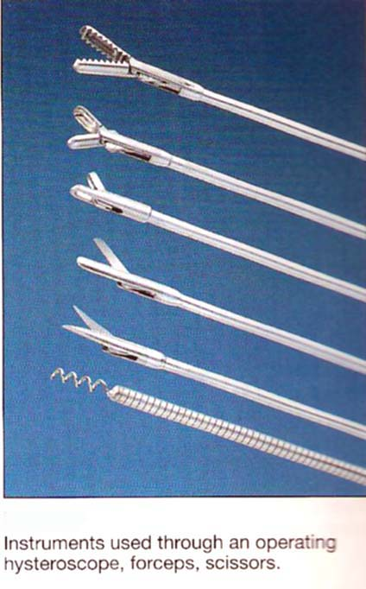
Technique
Chemical & Radioactive substances abandoned dt poor results
Cryo surgery proposed but didn’t work
High frequency radio waves
Resectoscope

Slide 59
Resectoscope
Instrument:
Telescope & continuous flow sheath system allowing for simultaneous in & out flow of the distension liquid used in the cavity to distend the ut. Cavity
Sorbitol / mannitol/glycine solution as continuous flow irrigation pump to have clear field
Resection & Coagulation
Endometrial slices of 3-5 mm thickness is resected
50-100W unipolar electrosurgical generator can be connected to Resectoscope
The terminal portion has U shaped loop for endoscopy-guided resection

Slide 60
Endometrial ablation Technique
Entire endometrium must be ablated; small islands of remaining endometrium may otherwise give rise to widespread recolonization of this epithelium
The entire endometrial thickness must be ablated but should not be deep enough to myometrium
Normally the epithelium in the isthmus region is spared in order to prevent a total Asherman’s syndrome
It would be ideal to maintain the possibility of inspect the uterine cavity for the follow up
Hysteroscopic guided techniques are preferable over blind methods bcz > effective, can detect other intra uterine pathology

Slide 61
Technique
Roller Bar Coagulation:
Variation of previous method
Terminal loop is replaced by roller bar
The roller bar electrode consist of a metal ball or bar connected to unipolar electro surgical generator & is used for systemic coagulation of the entire endometrium
Advantage:
Technically this method is easier as there is no risk of penetrating too deep into the myometrium
Disadvantage : endmt . Can not be collected for H/P exam.
Ideally It can be used along with U loop specially to assess the corners of tubes

Slide 62
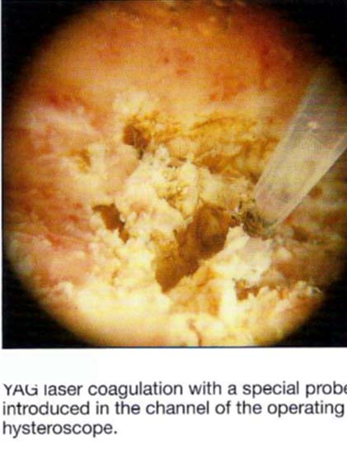
Neodymium Technique YAG Laser Coagulation:
Similar to electrosurgical coagulation but performed with Laser
Thermal Ablation Technique:
Balloon Thermal Ablation

Slide 63
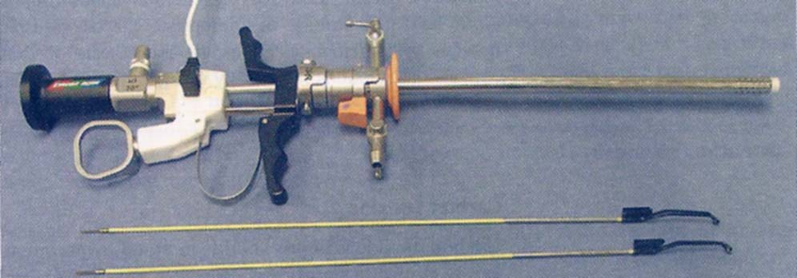
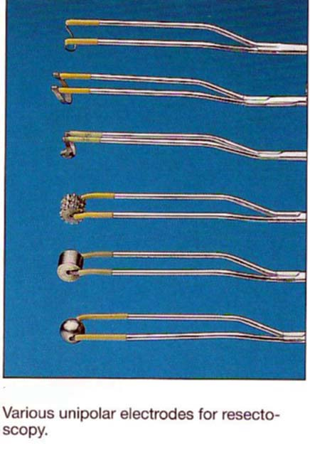

Slide 64
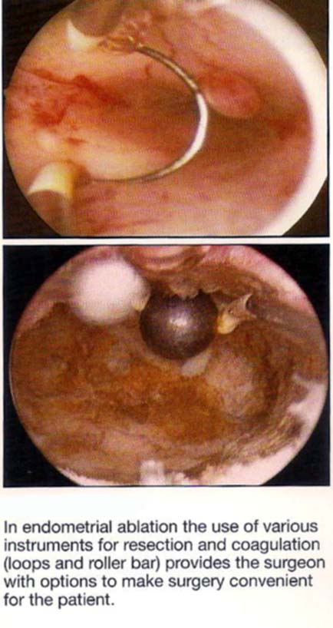

Slide 65
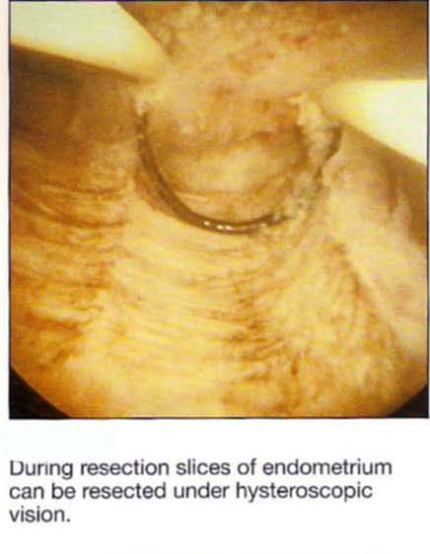
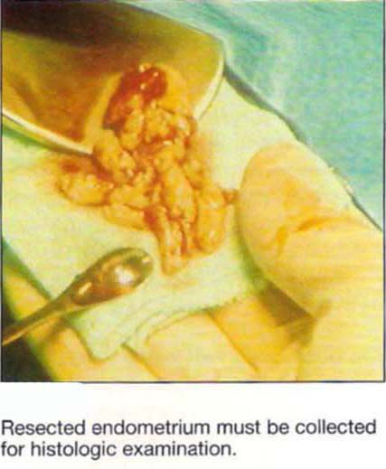

Slide 66
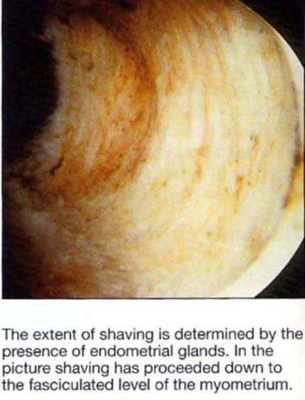
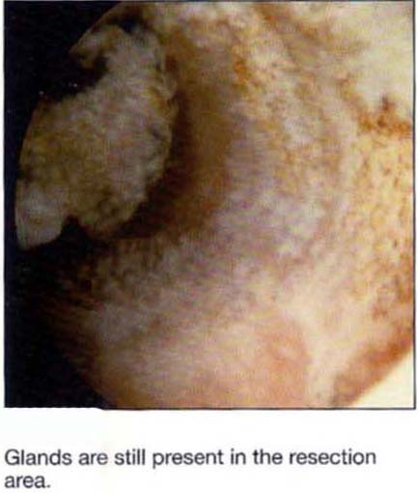

Slide 67
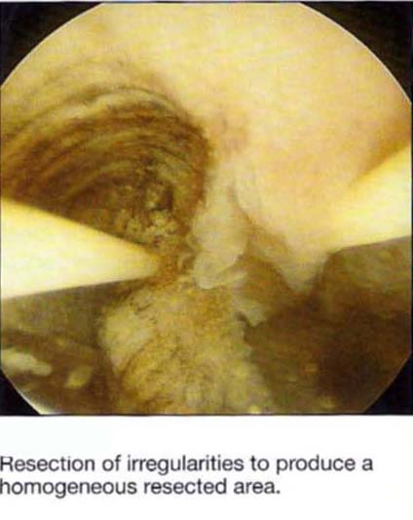
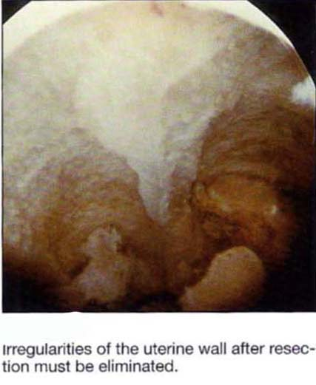

Slide 68
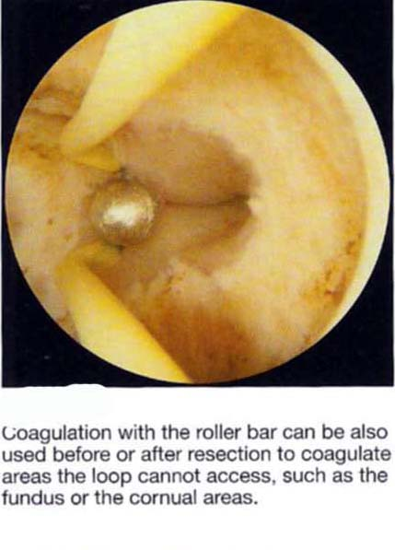

Slide 70
Endometrial Ablation
Results:
Symptoms Remission: 90- 95%
90-95% SUCCESS RATE

Slide 71
Causes of Failure
Most common presence of Adenomyosis 89%
Uterine dimensions : hysterometry >12cm increases the failure rate
Curettage immediately prior to surgery worsens the results of ablation itself
The surgeon ‘s skill
The correct pharmacological preparation with analogs or with danozol significantly improves the result

Slide 72
COLPOSCOPY

Slide 73
COLPOSCOPY- INTRODUCTION
Was introduced by Dr. Hans Hinselman in 1925.
The word “colposcope” is derived from the greek words kolpos (fold or hollow) and skope (examine).
Method of examining the cervix, vagina and vulva in vivo using a microscope (colposcope) and an external white light source.
Objective –to detect intraepithelial and early neoplasia of cervix, vagina and vulva

Slide 74
INDICATIONS
Evaluation of women with-
Pap smear reporting of epithelial cell abnormality, with no gross lesion on the cervix or vagina
Presence of inflammatory cells despite adequate treatment
Presence of keratinized cells
Positive visual screening tests-VIA or VILI
Positive high risk HPV DNA test
Post coital bleeding & post menopausal bleeding
“Unhealthy cervix or vagina” on naked eye examination
Exposure to DES in utero
Anogenital condylomas and subclinical HPV infection
VAIN or VIN
Also used for monitoring of women treated for CIN and preop evaluation of women diagnosed having cancer cervix stage 1 (to rule out involvement of vagina)

Slide 75
Tissue basis of colposcopy
The epithelium and stroma have a reciprocal relationship. Epithelium acts like a filter through which redness of stroma is transmitted. The image is dependent upon the ratio of absorbed light and reflected light and depends upon:
The thickness of the epithelium
The morphology and organization of the epithelium
The vascularity and nature of the underlying stroma
Tissue chromophores
Red blood cell hemoglobin

Slide 76
Steps of colposcopy
Patient laid down in lithotomy position
Bivalve self retaining vaginal (Cusco’s) speculum is introduced
After saline wash, any gross lesion,vascular details and opacity of the epithelium noted.
Green filter- to evaluate vascular details. Green filter absorbs red colour & blood vessels stand out as black streak against translucent epithelium.

Slide 77
International Federation for Cervical Pathology and Colposcopy (IFCPC) Colposcopic Classification (2002)
II Abnormal colposcopic findings:
Flat acetowhite epithelium
Dense acetowhite epithelium*
Fine mosaic
Coarse mosaic *
Fine punctation
Coarse punctation *
Iodine partial positivity
Iodine negativity *
Atypical vessels *
* Major changes

Slide 78
Give your feed backs about the content

Slide 79
Take home Message
Hysteroscopy is an important procedure to evaluate uterine cavity, cervix &vagina
It can be used as diagnostic & therapeutic
The role of hysteroscopy in perimenopausal & post menopausal bleeding is invaluable
It permits to take the biopsy under direct visualization than blindly by D/C
Endometrial ablation is good alternative in women who are neither willing to continue medical tt nor wants to go for hysterectomy.
The case selection& the skill of the operator is hallmark to achieve good results & less failure rates

Slide 80
Indications
Abnormal Pap smear
Abnormal VIC
Abnormal VIA
Abnormal VIL

Slide 81
Hysteroscopy in Peri-menopausal Bleeding
Abnormal uterine bleeding is most common problem in a women >40 yrs of age
Various diagnostic techniques ( D/C, EB, Vabra suction curettage, Challenge test, HSG, TVS ) has been proposed
Hysteroscopy as an out patient procedure in combination with endometrial biopsy has demonstrated its great potential as a method of 1st choice in the management of Abnormal bleeding

Slide 82
Colposcopic Findings
Acetowhite epithrlium
Leukoplakia dt Keratin producing cells
Atypical vascular pattern- invasive cx ca
Mosaic or punctate
Irregular surface contour with loss of surface epithelium
Color tone change yellow orange
Cx Biopsy

Slide 83
Thanks

